Slide 1

Explainable AI - XAI
Sachith Gunawardane

Slide 2
Agenda
Dataset - Breast Cancer Wisconsin
EDA
eXplainable AI
EBM
LIME
SHAP
Comparison
Reference

Slide 3
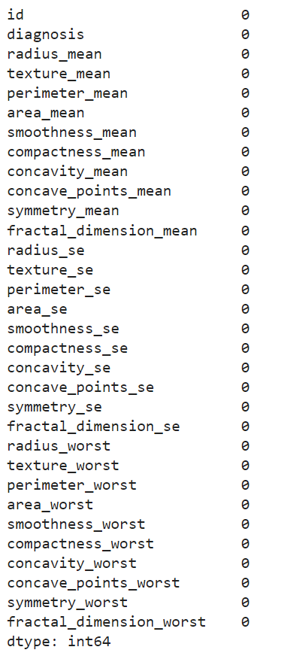
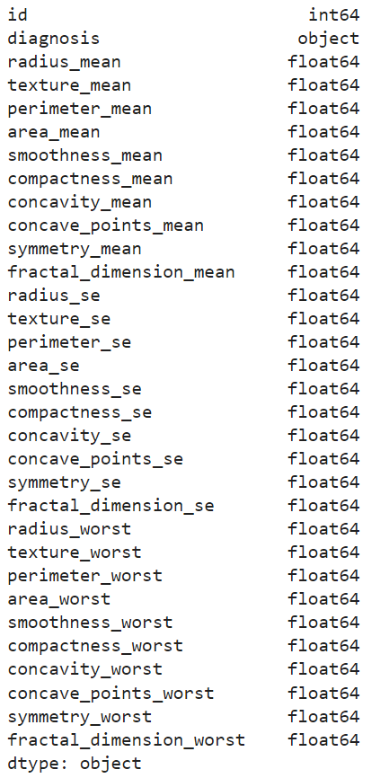
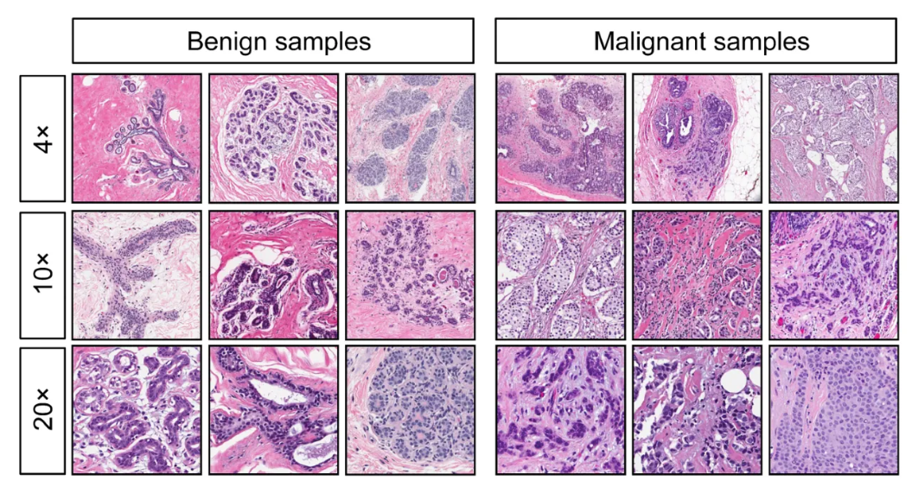
Breast cancer Wisconsin dataset & EDA
Missing Values
Data Types
Link to UCI ML Repo

Slide 4
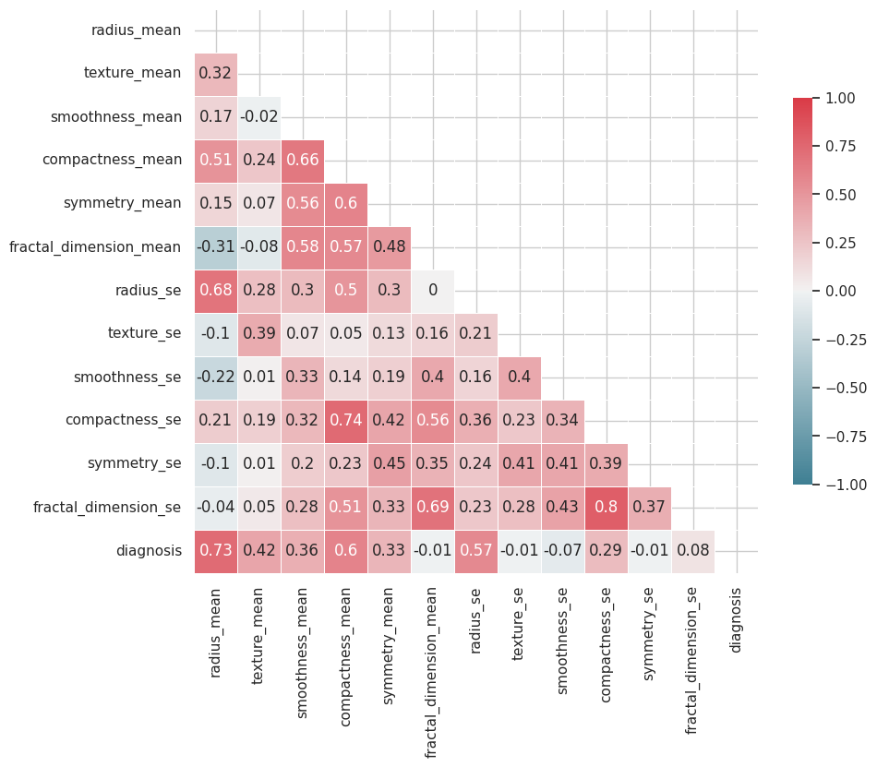
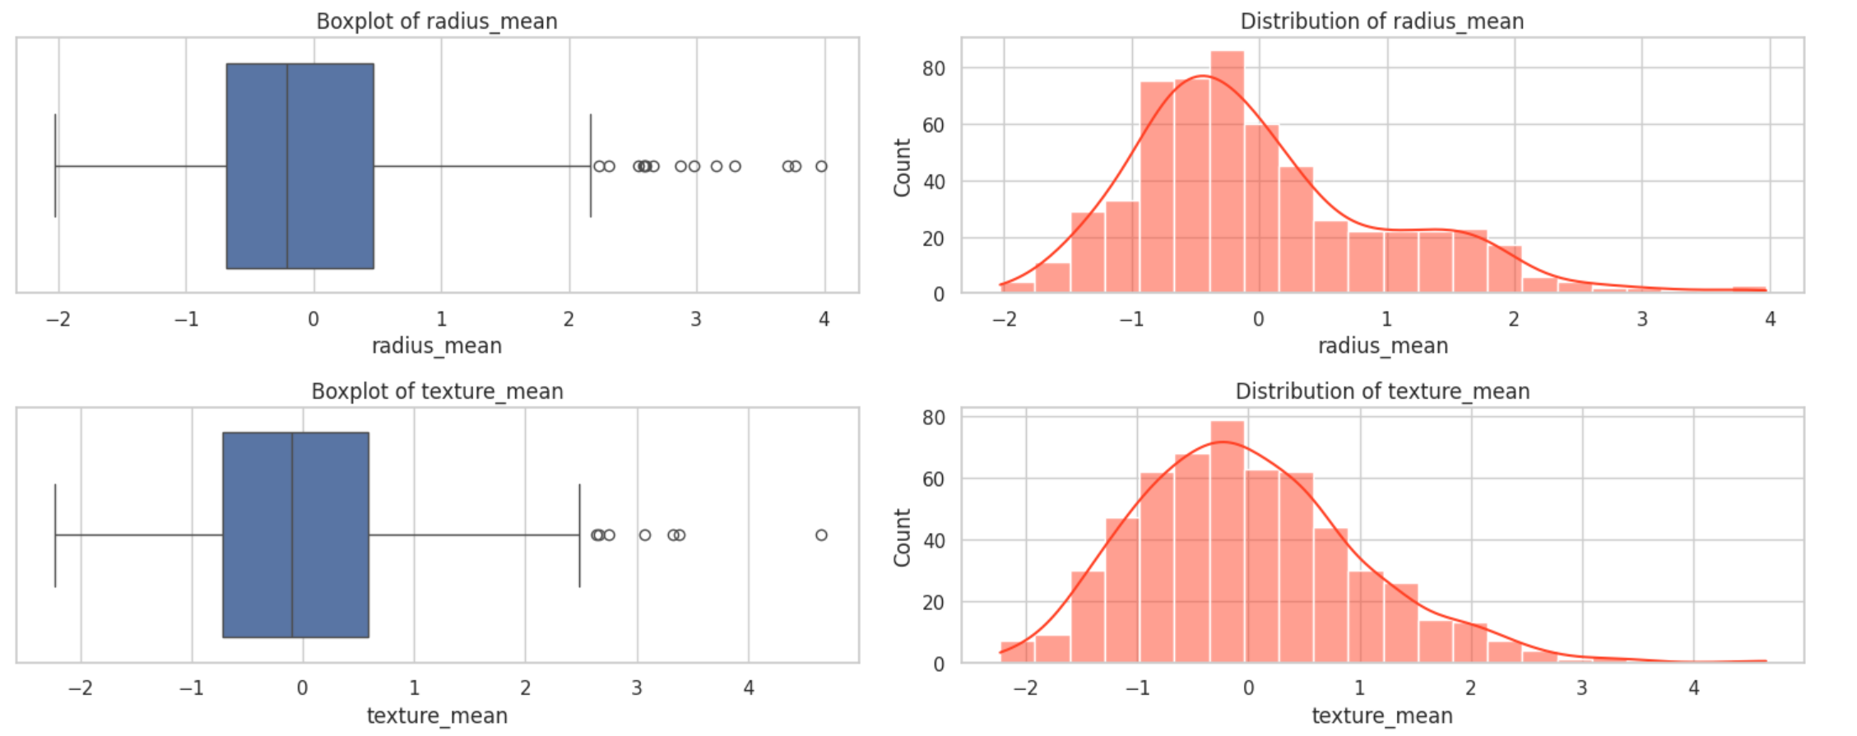
EDA
Correlation Matrix
Univariate Analysis for Numerical Features

Slide 5
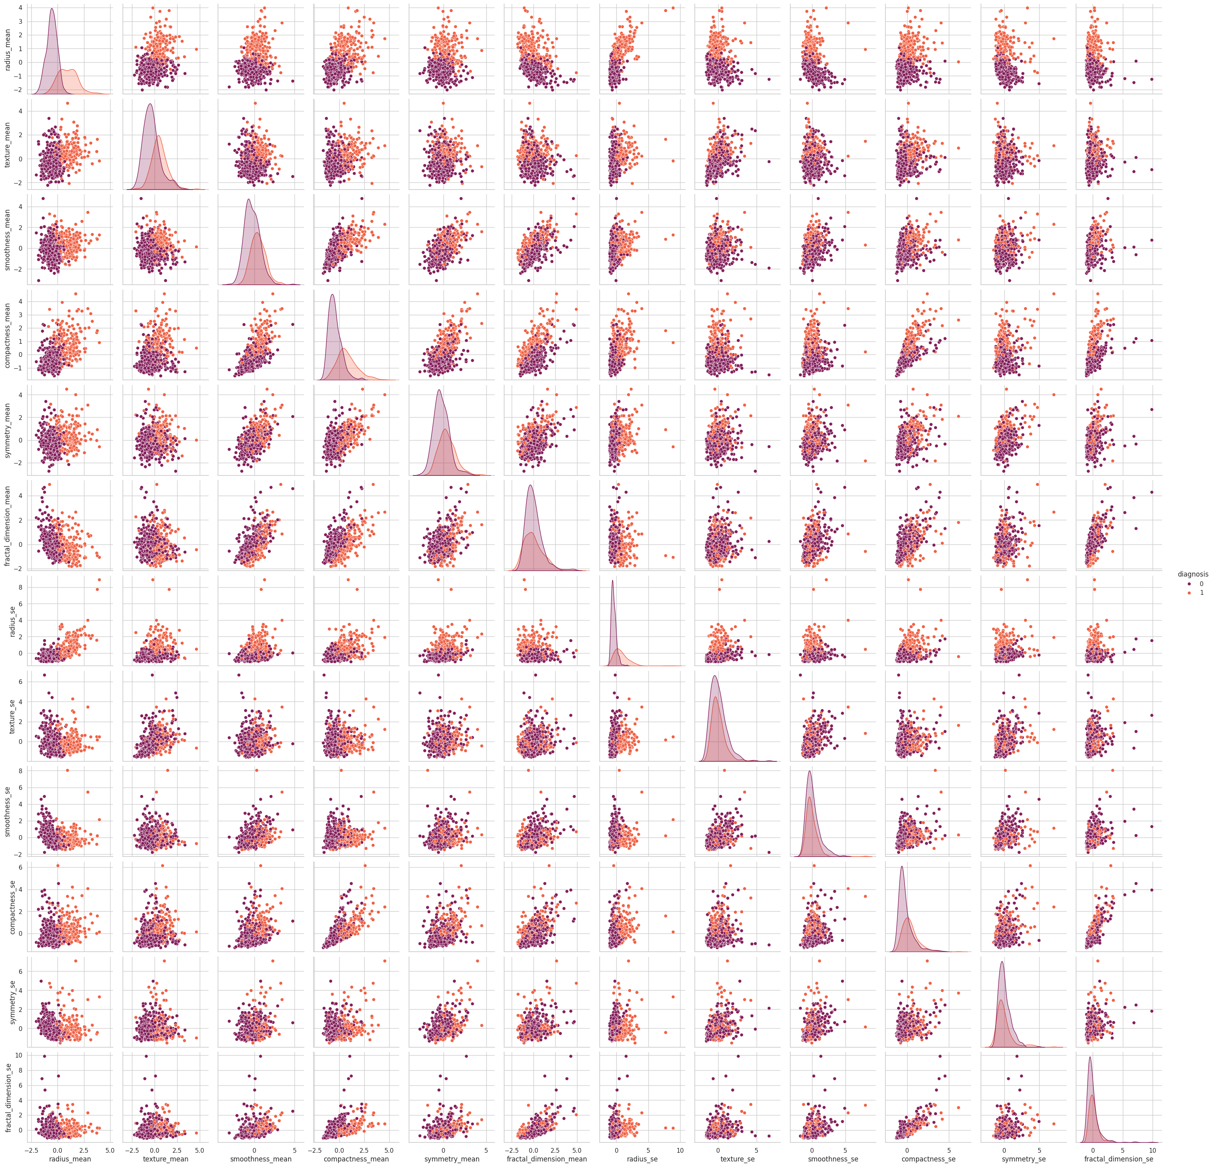
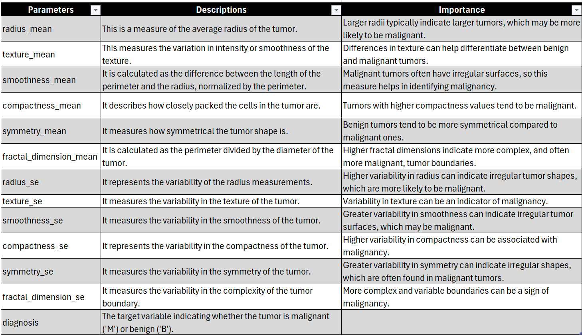
EDA
Pair Plots

Slide 6
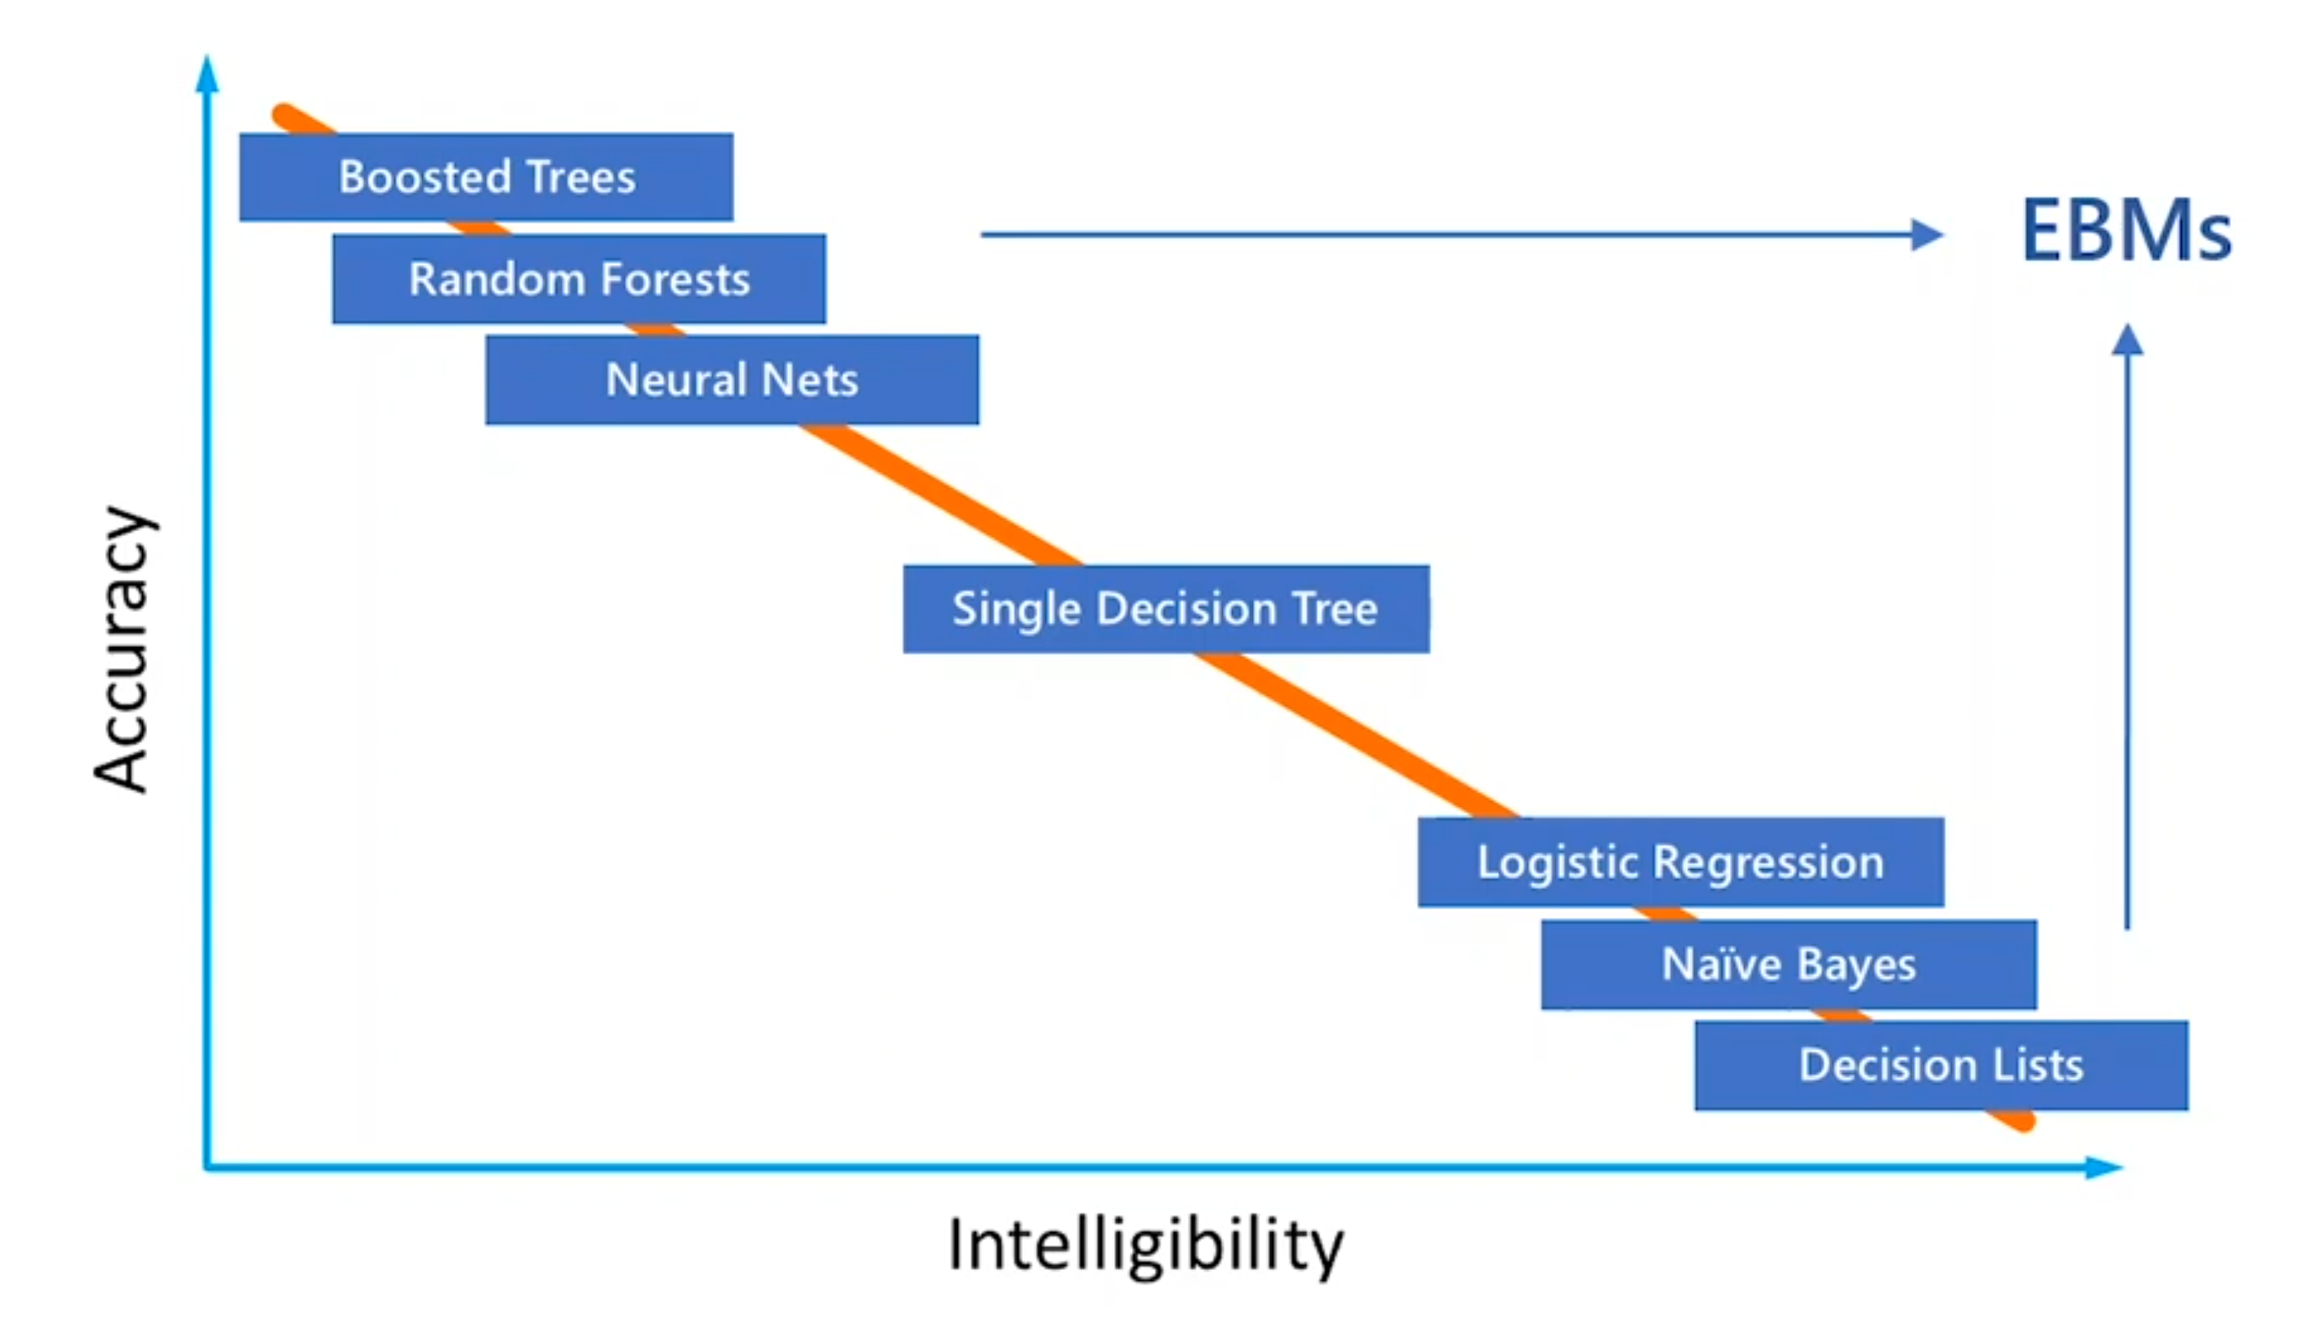
explainable AI

Slide 7
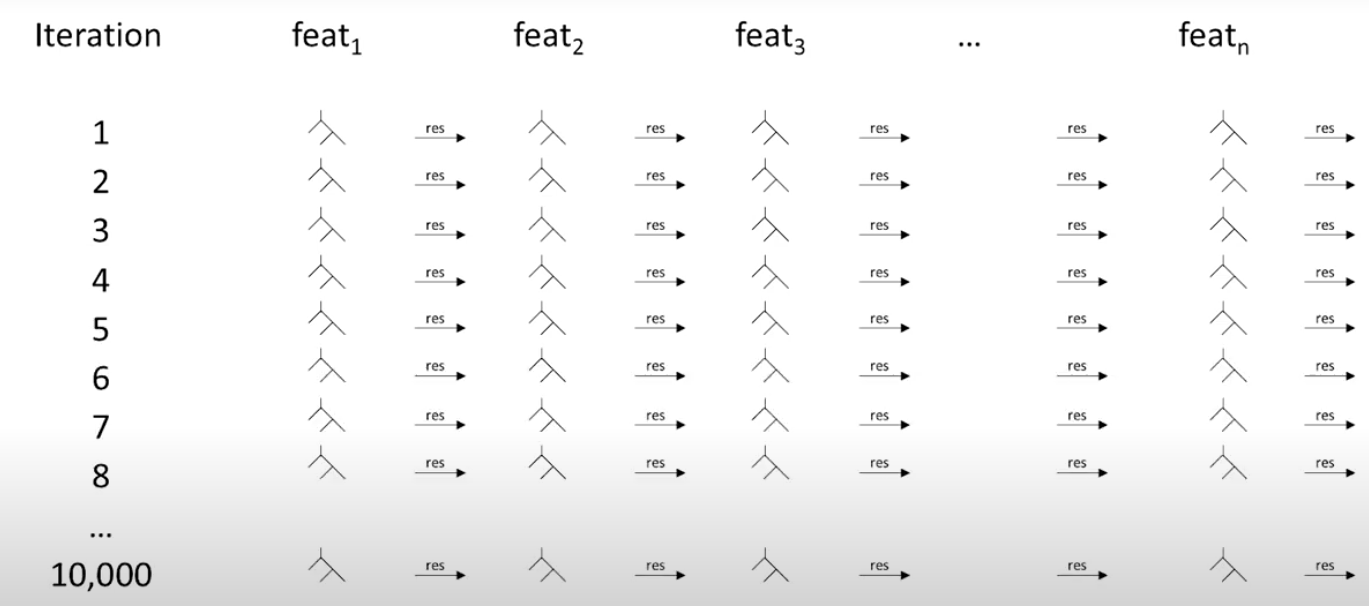
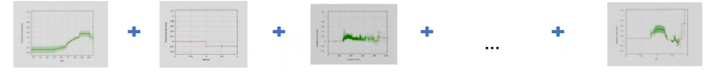
Explainable Boosting Machine - EBM

Slide 8
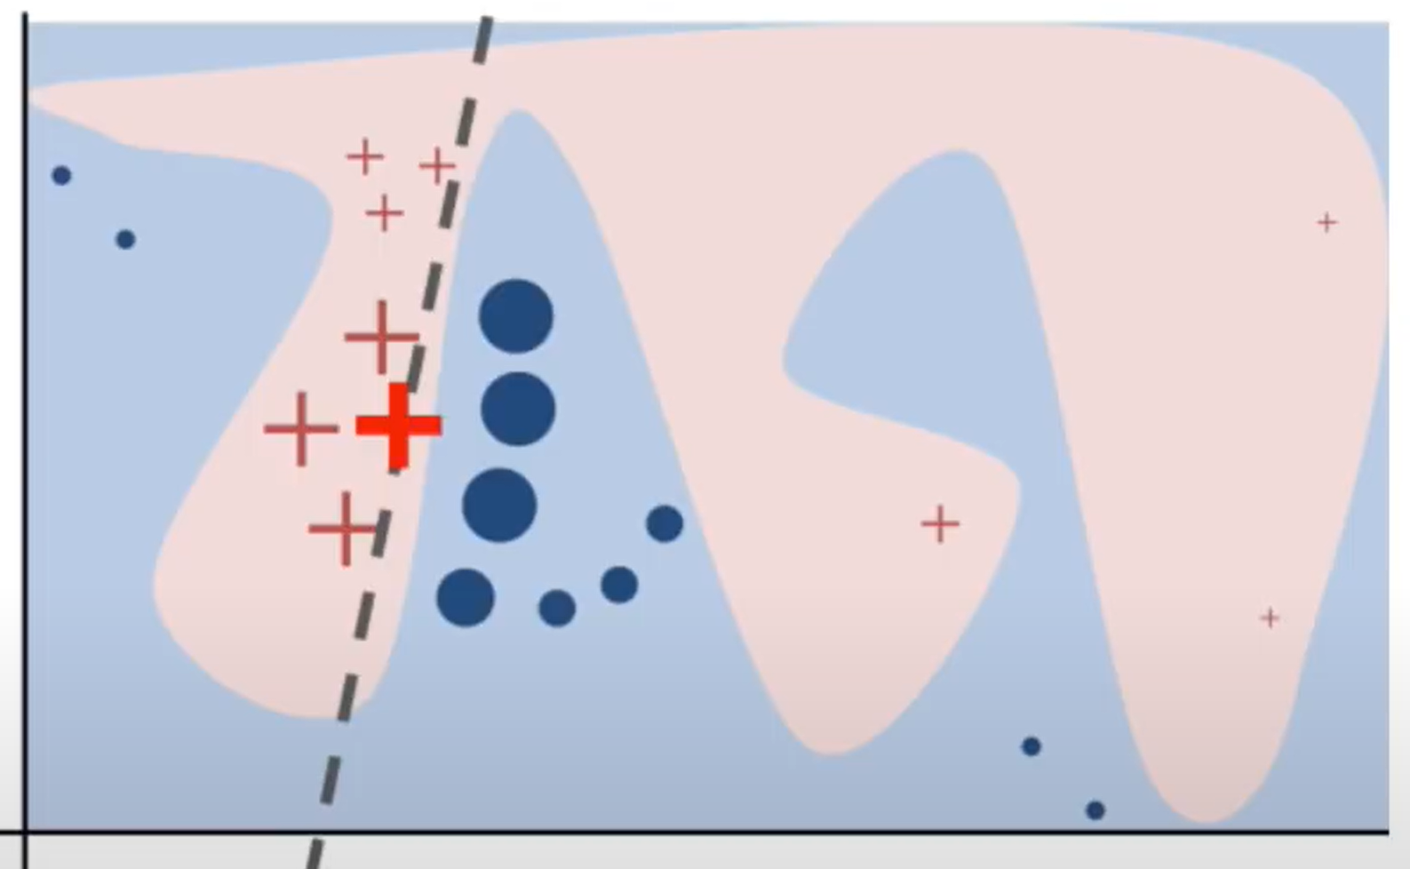
LIME – Local Interpretable Model-Agnostic Explanations
How does it work?
Supported Data Types
Tabular Explainer
Recurrent Tabular Explainer (Time series)
Image Explainer
Text Explainer
Drawbacks
Depends on the random sampling of new points, so it can be unstable
Fit of linear model can be inaccurate
Relatively slow for single observation, in particular with images

Slide 9
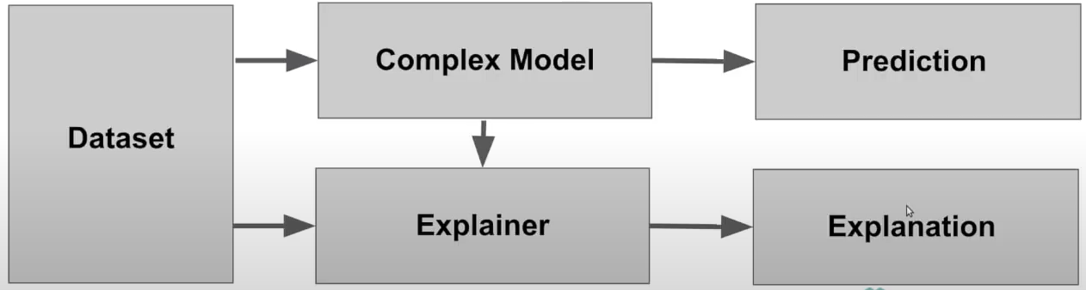
SHAP – Shapley Additive explanation
In SHAP, the weight of each feature is computed using the Shapley values method from game theory.
To get the importance of features X{i}:
Get all subsets of features S that do not contain X{i}
Compute the effect on our predictions of adding X{i} to all those subsets

Slide 10
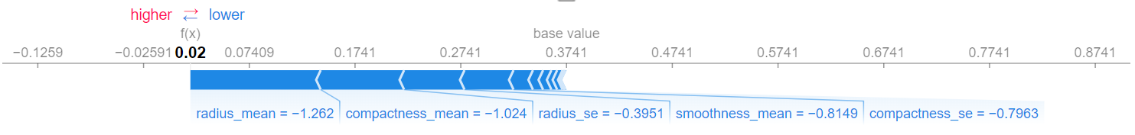
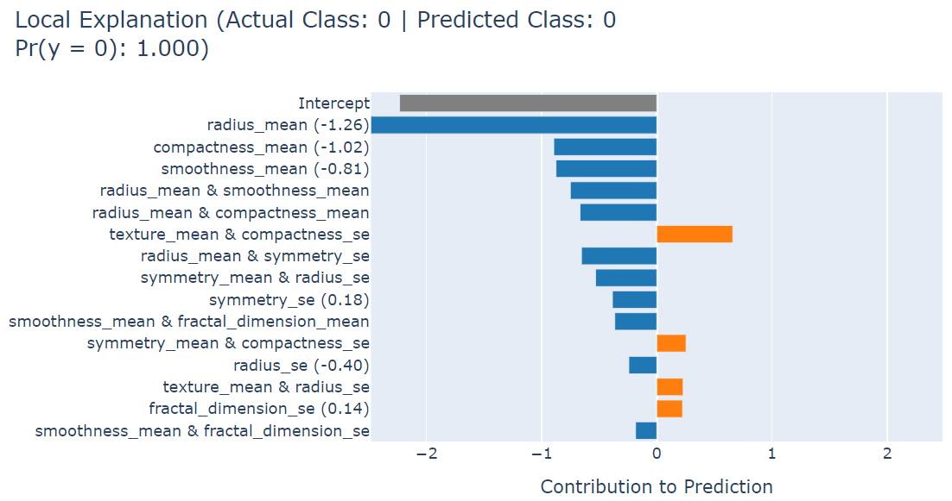
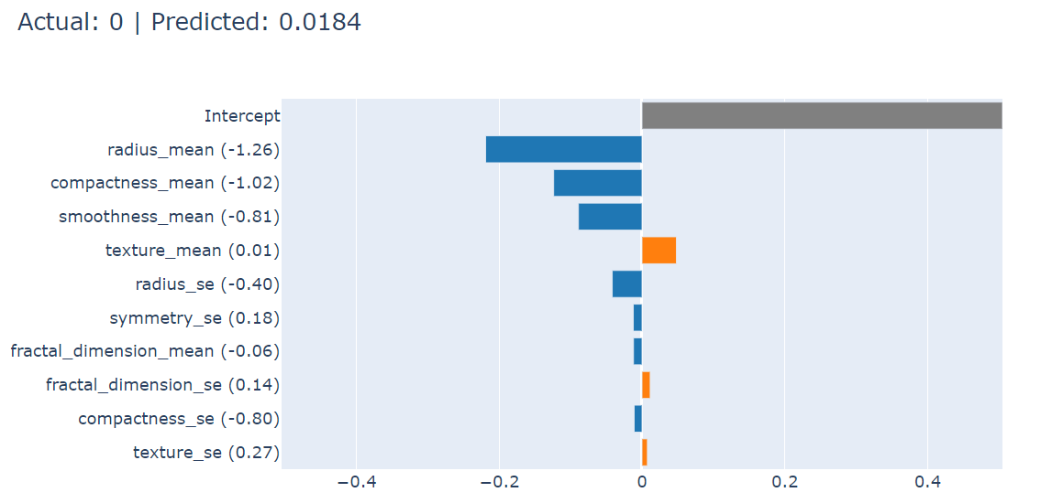
Comparison (LOCAL) – EBM / LIME / SHAP
SHAP
EBM
LIME

Slide 11
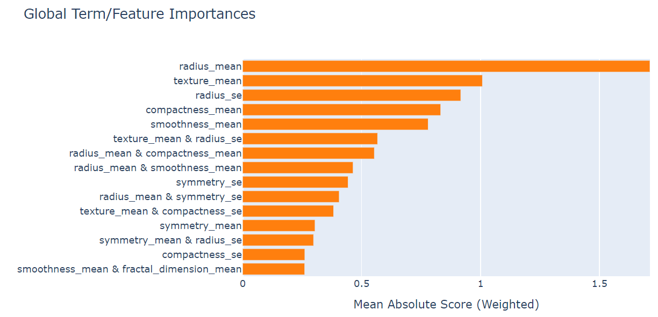
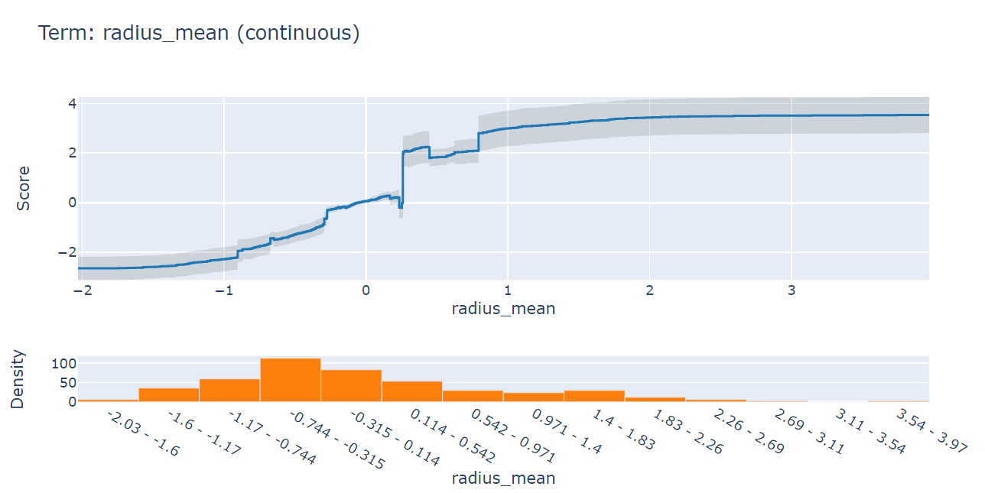
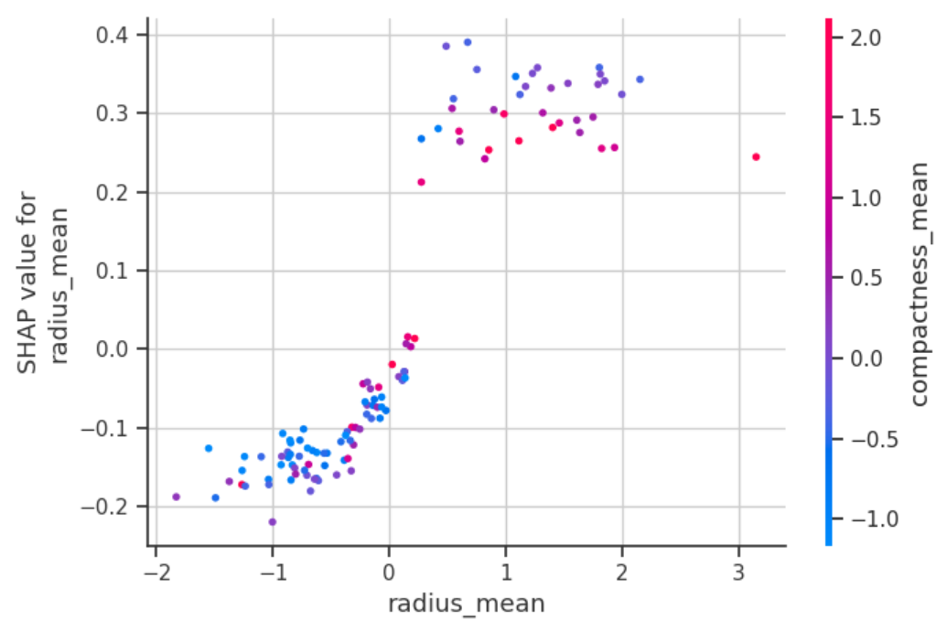
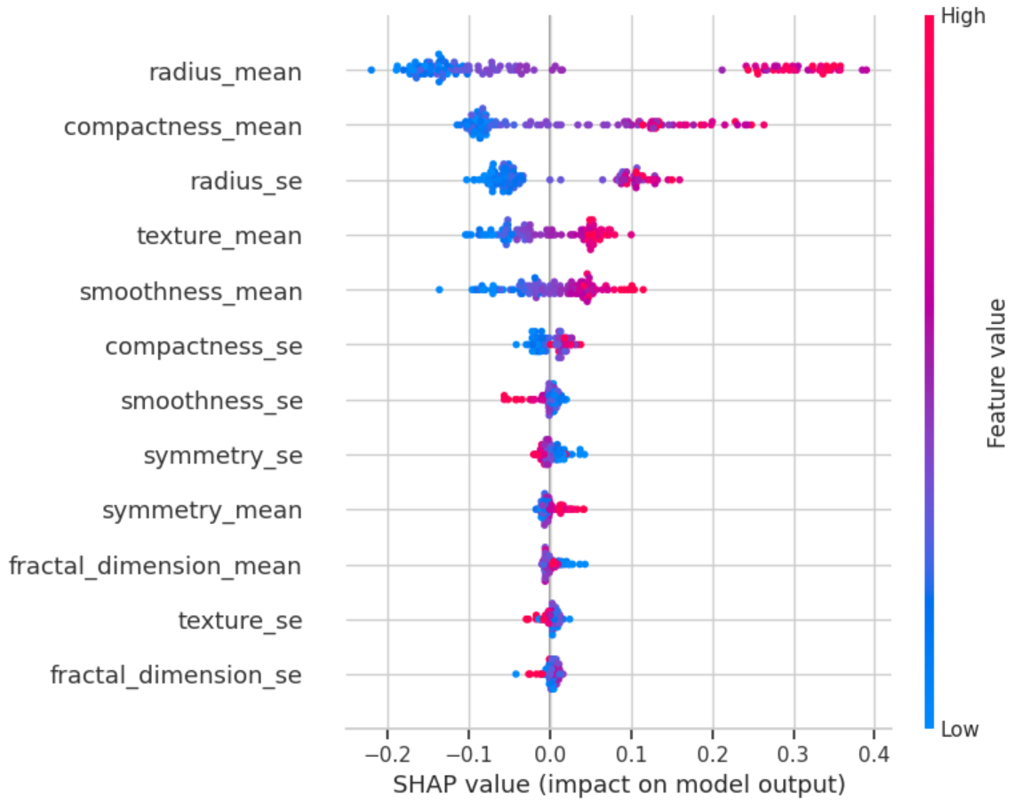
Comparison (Global) – EBM / SHAP
EBM
SHAP

Slide 12
References
https://www.youtube.com/watch?v=C80SQe16Rao&t=4566s
https://www.youtube.com/watch?v=9haIOplEIGM&list=PLV8yxwGOxvvovp-j6ztxhF3QcKXT6vORU&index=4
https://medium.com/analytics-vidhya/shap-shapley-additive-explanations-and-lime-local-interpretable-model-agnostic-explanations-8c0aa33e91f
https://github.com/deepfindr
https://www.smeddinck.com/post/2022-03-17_humanaiinteractionlecturesatik2022/
https://medium.com/@zhonghong9998/interpreting-deep-learning-models-techniques-for-understanding-predictions-470b521ec401

Slide 13

Thank you

